Slide 1
IBM Data Fabric

Slide 2
Data Frabic Explained
https://www.youtube.com/watch?v=0Zzn4eVbqfk&t=602s

Slide 3
Terminology
Classification
  Methods
    Data Fabrics – Architectural Approach to break down and get into the hands of data users
      Accessing, Ingesting, Sharing across an Enterprise in a governed matter
    DataMesh
  Tools – Traditionally Large Central Repositories for clean and organized business data
    Cloud Data Warehouse
    EDW
    Data Lakes Use for Unstructured Data Sources. Dump data in quickly and clean and analyze later on
    Data Houses Flexibility in type of data with the ability to scale as a Data Lake, with more quality data ( data warehouse )

Slide 4
Data Fabric
Responsibilities
  Accessing Data
    May be in EDW, Data Lakes, RDMS, Cloud, Files – Need to collect information from all these source without copying/moving a ton of data
      leverage a virtualization layer so the data does not need to be moved or copied
      only copy data when there are latency requirements or formal pipelines – Use ETL Code to clean and load into the central repository
    Managing the Lifecycle of the Data
      Governance and Privacy
        Only those who the data set the data
        Use Active Metadata to automate enforcement of policies
          Mask certain aspects or redact details
          Roles Based Access Control
          Rich Lineage information
            What Transformations were done on it
            Access for Quality
      Compliance
        Regulations ( GDPR, CCPA, HIPPA, FCRA)
    Exposing Data
      After connected to and our governance polices have been defined
      through Enterprise Search Catalog(s) – to Business Analyst, Data Sciences, AppDev using ML Platforms and Business Intelligence or languages such as Python/Spark
      Trust Worthy AI – Robust ML OPS tools to help monitor bias, fairness and explainability in the results

Slide 5
Example
Customers want high quality and personalized experiences
  Walk into a Hotel and no provide redundant info and receive offers relevant to use.
  Hotel
    Data Sources :
      Enterprise Warehouse might have customer data.
      Unstructured Source. : Sentiment Analysis from Social Media
      Inject Customer Review Data
      Pull Credit Card Data
    Next we Master Data Management Tools
      Is the information accurate
      Is it the correct customer
      Then we can mask certain data such as credit card numbers
    Publish the Datasets into Catalogs which can be accessed by the users.
      Use for many things such as recommendation engine, application for Guest Services

Slide 6
What is IBM Data Fabric
https://www.youtube.com/watch?v=VqpYIZw0rgI&t=934s

Slide 7
2nd Video
A methodology on how the data is managed
Steps
  Where is the data coming from
    Come from different places ( locations and formats )
      RDMS, XML, JSON, S3, NoSQL
      Data Warehouse
      Consolidating data and putting it in a Data Lake
      Services : Cloud, Rest
    Need to connect, authenticate and interact with them
    Aggregating and Visualize Layer
      How do I aggregate the data to tell a story
    Integration
      Don’t copy the data unless necessary for better cost and performance
      ETL, API with different sources

Slide 8
2nd Video
  Life Cycle Management
    Who able to access the data
    Identify the quality of the data and make it better
    How long does it remain fresh
    privacy
      provide context to the data – Role Base Accessed Data
      least privilege for the data
      Redact the Data – Only show what is relevant
    Data Lineage – Track how the data has evolved
    Compliance – Ex. HIPPA, FLRA
  Exposing Data
    How Do I expose it to the correct people – Enterprise Search Catalog
    Predictive Analytics
    Trust Worthy AI – Comes from a Rich Set of Tools
      How do I deal with Bias and fairness and Explainability

Slide 9
What is a Data Frabic and how does it work

Slide 10
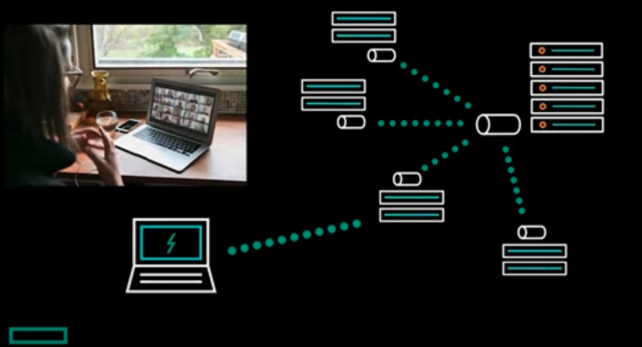
Example
Example How does streaming video actually work (diagram – First Picture on the Right.)
  1st idea – Throw meta data in a message stream and send it back
    At a fabric level –You have single object that lives in many different data centers
    One Data Structure can span the enterprise and get a global view
    Replication is at the fabric level
    Sections of code don’t need to know about other section
      Source does not need to know about connections
  Strong separation of concerns
Example Autonomous Cars
  Data can be collect from large amount of cars driving on the roads and the data is copied to the field stations
    From the field stations does a bulk copy back to the corporation
    Petrabytes of data per day
  Run Analytics in the field so only the data needed is copies
Data Scientist – Working on shared data allows faster model learning ( Multitenancy becomes a key requirement )
  single instance of software runs on a server and serves multiple tenants.

Slide 11
History
Unix gave us the ideas of file/directories/ block devices ubiquitous
  limited scale to a single machine
Hadoop – Gave up compatibility of the older filesystems to get scalability
People are more willing to compromise : Scalability / Reliability
Example running AI and Analytics breaks apart communication and team work.

Slide 12
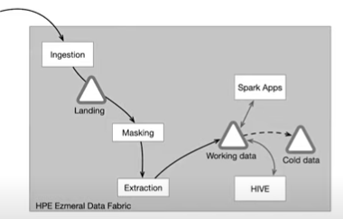
Example
Steps
  1st Step
    Get data from a lot of banks and would set up servers and store the data on a local disk of the server. Would have load balancing between backs – limited
  2nd Step
    They add an NFS Appliance and would execute masking an extracting and put it back on the NFS Disk
  3rd Step
    Added HDFS and Hive ( analytics) where the data was copied to.
  4th – Machine learning
    Copy it to S3 to be used on Spark Apps
    Copy to Cold Object Store – Lower Cost Backup Storage
Problem : A large amount of systems to maintain
  the majority of the work is copy
  Better Way Injection works with Data Fabric and route data into a volume ( easy to scale and secure )
    Masking and Extraction are done one secure data and the data is put into a working directory where analytics and machine learning can use it
    Can have volume for cold data
  We are not dealing with one system

Slide 13
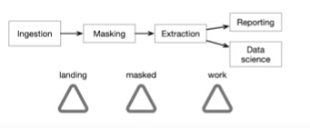
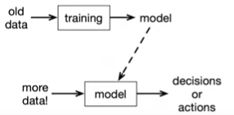
Example
DevOps View
  Don’t have to think where the computation runs
  The data is in a small amount of volumes
    Don’t worry about where data is
    Manager security on few volumes only
  Worries about function
Infrastructure Team
  Maintain one storage system that can scan to multiple data centers and one
  scalable computation environment
  Think about Data Fabric and Stuff
90 percent of successful machine learning is logistics
  Example Machine Learning
    Configuration, Data Collection, Feature Extraction
    resource management, analysis tools, Process Management Tools
    Serving infrastructure, Monitoring

Slide 14
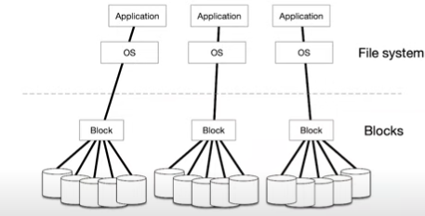
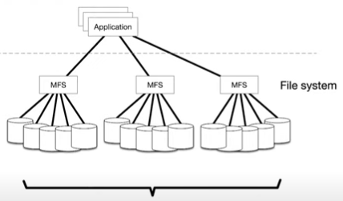
Boring Parts
Boring Stuff
  Data Transfer and Copy
  Managing models
  Lifecycle of the system
They are very important for making the system run properly
image on the right.
  Traditionally using block storage ( fashion the disk into a resource
  by using something like linux volume manager )
  Do not span and located on one machine
2nd image on the right
  Make the file system full distributed which hides location of the data

Slide 15
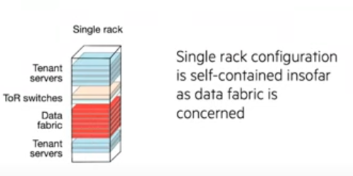
Hardware
5 or more servers to get lots of redundancy
Scale by adding hardware

Slide 16
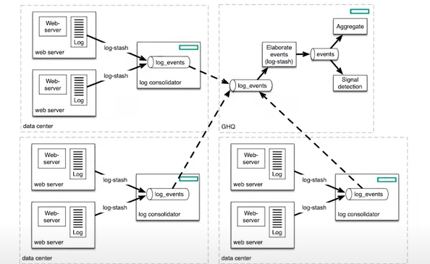
Geo Distribution
There are data streams, message streams build into the filesystem that underpins
the data fabric
  They are primitive objects like files or directories that live in directories
  Have a different API to express the lifecycle differently
  Message Streams can replicate to other message streams, but the topic should
  have one origin
    Coding Standard: name topic.machinename.metricname
  Can process them simply ( see the entire world in a drop of data )

Slide 17
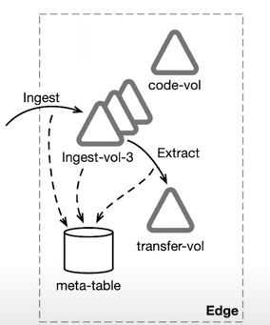
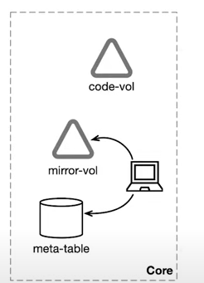
Moving Data
move entire volumes at one time
Have bidirectional table replication – mirror data
Edge
  Can have time stamp volumes and nice to have a
  volume for each timestamp so that deletion
  is easier
  Record data in a table – Has a NoSQL database built
  in to create a table as easy as a file
  code-vol – For extraction and analysis code
Core
  Have meta-table, mirror-vol and code-vol
  Run special applications and big machine learning
  and applications

Slide 18
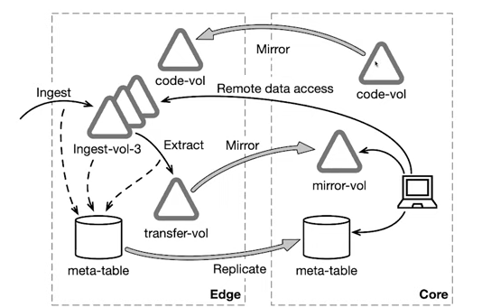
Mirroring
Replicated in near real time
Mirroring – Takes a moment in time and only moves the changes from the last
mirror
Can use the same filename for data at the edge and the core
Works over geographic scales

Slide 19
Volumes
Volumes look like directories to programs and most users, but they give use management powers of how data is stored.
Volumes form tree just like directories and we have shadow of volumes that show replicated
  Erase Code

